Slide 1
Great Theorem: Evaluating the Sum of Square Reciprocals
Euler
Journey Through Genius Pp 212

Slide 2
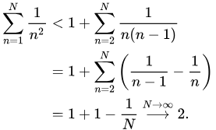
Notes on the Proof:
This particular series had been examined by the Bernoulli brothers and Leibniz, stumping them all, along with the rest of the mathematical community They all had known that it summed to less than 2, but no one was able to find the precise solution Euler carried out the series and calculated it up to 20 places, to try and recognize the sum, he found it was tending toward 1.6449, but his number did not look familiar to him

Slide 3


Two Preliminaries
The sine function -- written as an infinitely long polynomial
P(x) is an nth degree polynomial, suppose as its n roots we have x=a, x=b, x=c, … x=d, so P(a)=P(b)=...=0. Suppose further that P(0)=1.

Slide 4
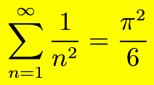
The Great Result,

Slide 5
Let us examine, closely, Euler’s argument.

Slide 6

Euler started with this function
He then observed that for x≠0

Slide 7
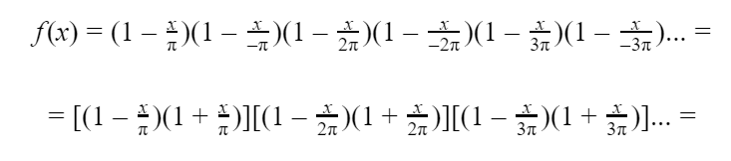
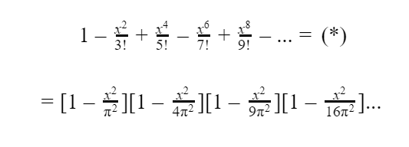
As long as x is not 0, we can factor f(x)=0, which amounts to solving sin x = 0.
Euler has related an infinite sum to an infinite product

Slide 8


Euler’s infinite multiplication problem would result in,
Now we have two series (*)(**) that are equal to one another, which implies that each coefficient preceding all powers of x are equal

Slide 9


Some simple algebra yields,
Q.E.D

Slide 10
Notes on the Argument
What an astounding conclusion, that the sum of this infinite series has generated an answer involving which is associated with circles and numbers like 1, 4, 9, 16 arise in conjunction with squares, an outcome linking the two could have hardly been anticipated.
Even Euler was surprised by this result, the unexpectedness combined with the cleverness of his argument makes this a great theorem of the first rank

